Slide 1
MAC Address Filtering and Switchport for SOHO

Slide 2
Infographic Style
WELCOME To Our Presentation Slide
System Summary
Implementation Mac Filtering and Switch Port Access For SOHO is a project to explain how to secure the network from phissing and freeloaders.
Network Diagram
Describe network design that will help readers to visualize the network relations from each floor in the office.
Mac Filtering and Switchport
Explain why Mac Filtering and Switchport are used in SOHO
Simulation
Provide link for simulation on cisco packet tracer

Slide 3
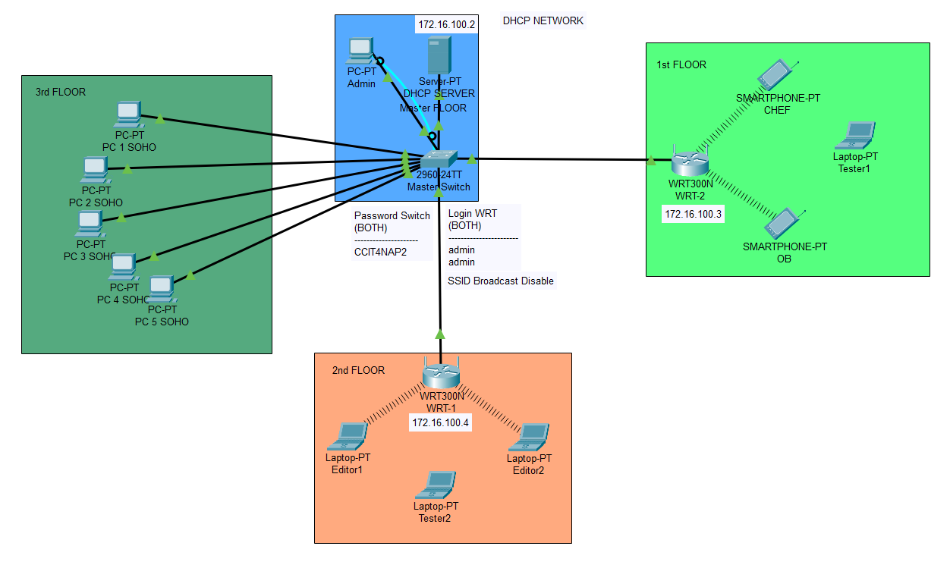
Network Diagram
Connect
Basic Security
SSID Broadcast
SOHO
For the new user / employee, they should ask permission to the admin
Wireless Device use Mac Filtering and WPA2Personal
Master Switch use Switchport for filtering the user that using the LAN cable
SSID broadcast are disable, that’s very important to ask permission to the admin
Our SOHO only provide 50 IP Address

Slide 4
MAC Filtering and Switchport Security
What is MAC Filtering and Switchport Security ?
Why we use MAC Filtering and Switchport Security ?
This MAC Address Filter feature works to help you prevent foreign (unwanted) users who intend to access your wireless router network. By implementing this feature, only wireless devices that have a registered MAC address (assigned) can gain access to the wireless router.
Switchport Security is control traffic that functions at the layer 2 data link. For devices that can be connected to a port on the switch.
We only provide up to 50 IP address, which is small and it’s manageable.
It’s very simple to set-up for new SOHO
It is secured pretty well for SOHO

Slide 5
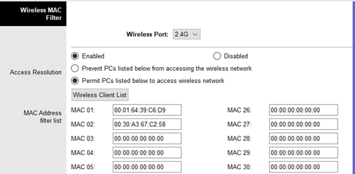
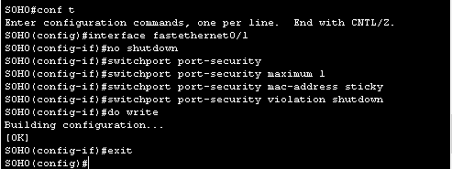
Here are Some Examples of the Configuration

Slide 6
Here’s the Link for the Full Configuration

Slide 7
That’s All of Our Presentation
THANK YOU
Hope You Enjoy

